Slide 1

Mass Infra Projects and Services
Purposely composed to perfectly execute

Slide 2
VISION AND MISSION:
Vision: We assure to be a benchmark for Pre-engineered structures and work with integrity and fairness. We ensure on time completion and give ear to client’s views and feedbacks
Mission: To set a standard for client relationship and deliver professional output with economic budget, proper finishing and optimum utilisation of resources

Slide 3

ABOUT US:
We being the expert in Pre-Engineering structures with 30 years of experience, started our journey in 1989 in the name ‘Hi-Tech Structurals Private Limited’ and continued providing esteemed services in the field till 2010
Undertaken many structural, interior works and telecommunication projects including HDD works in Muscat and UAE from 2011 to 2017
Recommenced our Pre-Engineering factory and office at Chennai in 2018 in the name ‘Mass Infra Projects and Services’ and extending our valuable services in Steel Structures, Civil Construction Works, Trenchless Ducting(HDD), Interior design and Decoration
We are driving Manufacturer of an ideal quality scope of PEB structure, Industrial Shed, production line shed, Prefabricated Structure, Prefabricated Industrial Shed, Prefabricated Factory Shed. Our offered range is broadly acclaimed for their ideal quality, consumption opposition, and toughness. Our range is outfitted with entrancing highlights, which are very valued by the customers. We are moreover experienced in making tweaked items according to the measurements referenced by the customers.

Slide 4
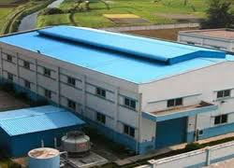
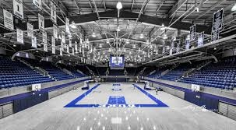
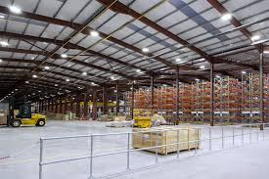
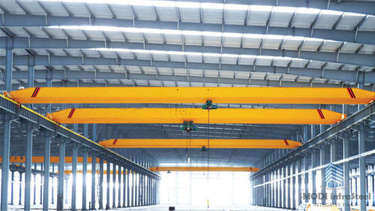
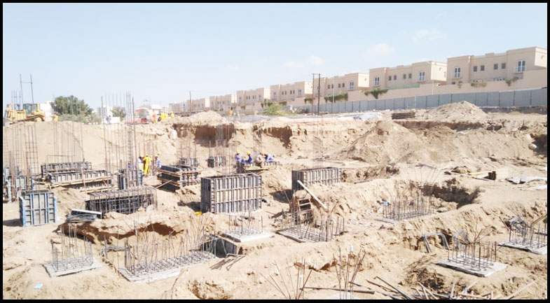
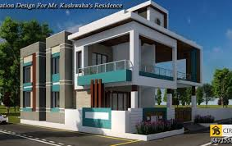
Areas of excellence:
Prefabricated Industrial Shed
Indoor Stadium
Warehouse
PEB structure with Crane
Civil Construction
Residential Building

Slide 5
Our clients
1. BHEL Ranipet
15. Bharath Electronics Limited (BEL), Chennai
2. Jayavilas Group – Rajapalayam
3. Central Public Works Department (CPWD), Govt. of India, Chennai
4. Hindustan Lever Limited, Bangalore
5. Brakes India Limited, Chennai
6. Chennai Petro Chemicals Limited (CPCL), Chennai
7. Hindustan Petroleum (HP) Petrol Stations, Chennai
8. Hyundai Power Projects Limited, Chennai
9. Lloyds India Limited, Chennai
10. ECCI, Chennai
11. Modern Food Industries Limited, Chennai
12. SPIC limited, Chennai
13. India Cements Limited, Chennai
14. TNCA, MA Chidambaram Cricket Stadium, Chennai.
21. India Shoes LimitedSimplex Concrete Plies (India) Lmited, Chennai
22. Paragon foot wares Group, Bangalore
23. Askok Leyland Properties Lmited, Chennai
24. Samyu Motors Pvt Limited (Daewoo Car Dealer)
25. KRS Car Care ( Tata Cars Authorized Service Centre)
26. Cars India Limited (Maruthi Suzuki Dealer)
27. Nagappa Motors (Hero Honda Bike Dealer)
28. DBS Properties Limited
29. MGM Group
30. Consul Consolidated Limited
31. Lalahs Pickles
32. Accurate bearing Components
33. Raja Magnetics Limited
34. Onam Agarbathi Co
35. Tarapur Constructions
36. Arvind Motors, Bangalore
37. ACME , Chennai
38. Malladi Drugs & Pharmaceuticals Limited
39. South India Corporation, Chennai
40. Titan Showroom, Bangalore
16. MRF Tyres, Chennai
17. Dunlop Tyres, Chennai
18. MM Rubber Co. Chennai
19. Joy Foams Limited, Chennai
20. PS Apparels Limited, Chennai1
41. Mactrics, Annanagar, Chennai
42. LS Group, Theni
43. Rajas Mall & Cinemas, Nagarkoil
44. Right Engg, Padappai
48. Iswarya Textiles, Rajapalayam
46. INS Rajali, Arakkonam
47. SRM College, Chennai

Slide 6
Specialisation
PEB STRUCTURE
PEB structures can be extended effectively and are intended to withstand all climatic condition without support. We put a great deal of exertion and commitment in each structure we construct with the goal that it produces an incentive for our customers.
PEB STEEL BUILDINGS
We supply a wide scope of Pre Engineered Building which is made of premium quality material which is sturdy and successful in application in development businesses.
PEB CONTRACTORS
We supply prefabricated buildings as a complete item alongside steel structures, building adornments and rooftop cladding.
PEB constructions require no on‐site manufacture or welding and they can just be blasted together according to detail. We go for giving brilliant PEB Buildings at reasonable cost all over India and to be a standout amongst the best PEB companies in Chennai.
Being a customer driven PEB structure producer, we generally guarantee that our endeavours create an incentive for our customers over the long haul.
We give the offered structure in different determinations according to the particulars of the customers. It is anything but difficult to introduce and upkeep free.
They are exceptionally appealing in appearance which is offered for/at practical rates at universal standards. To meet desires for the customers, we fabricate these Pre Engineered Building by making utilization of high-grade material and appearance innovation at our creation unit.
PEB INDUSTRIAL SHEDS
We have ability in designing, manufacturing Sheds to our esteemed customers. We create these sheds utilizing advance innovation guaranteeing subjective item at client's end.
Our talented specialists are fit for giving the ideal item to esteemed client in exacting consistence with their demands. We fabricate these sheds utilizing quality crude material that we obtain from dependable seller base guaranteeing longer useful life.
Our experts utilize high-grade apparatuses and supplies for creation and utilizing imaginative methodologies they manufacture these subjective sheds for our esteemed supporters.

Slide 7
CIVIL CONSTRUCTIONS
Residential Buildings
We are incredibly supported among customers for our positive administration arrangement
We offer pleasantries to proficient designing administrations for acquirement, coordination, manufacture, establishment administrations, erection of prefab items, electrical works and settlement for building group.
Commercial Buildings
Mass Infra Projects are the organization that pursues business morals to give finish customer fulfilment, and has earned an exceptional notoriety in the business sectors
Mass Infra Projects offer an item having huge highlights like dimensional exactness, low upkeep cost and best quality, consumption obstruction and hoisted toughness which are very esteemed by our clients.

Slide 8

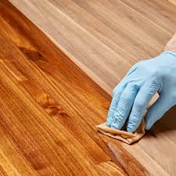

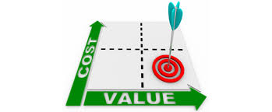
Why to choose us?
Perfect Finish
On Time
Economic
Flexible

Slide 9
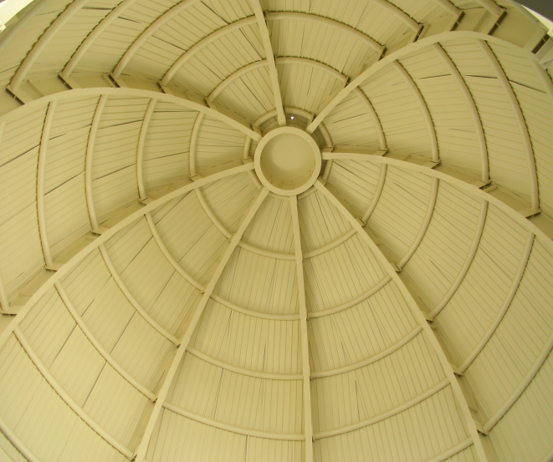
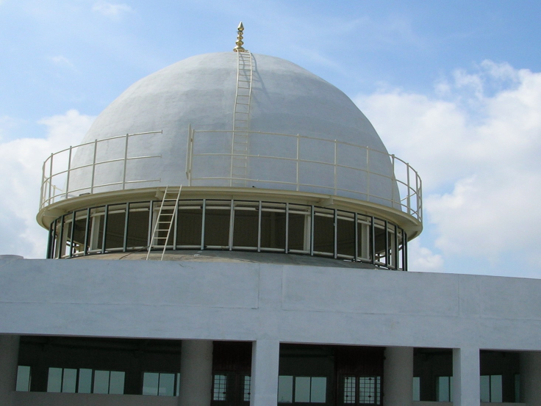
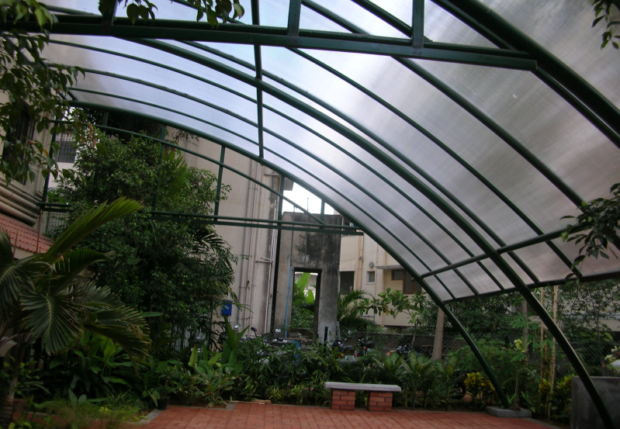
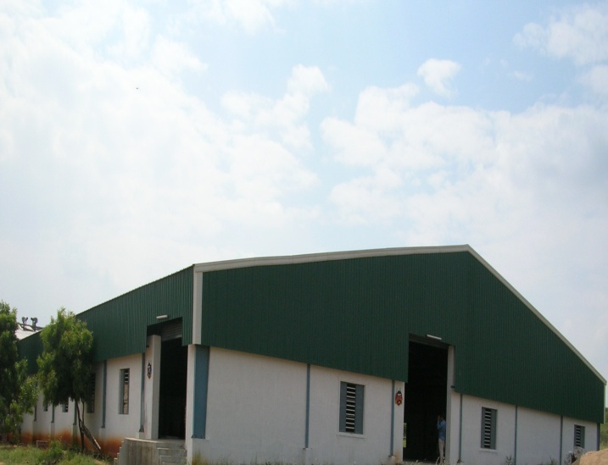
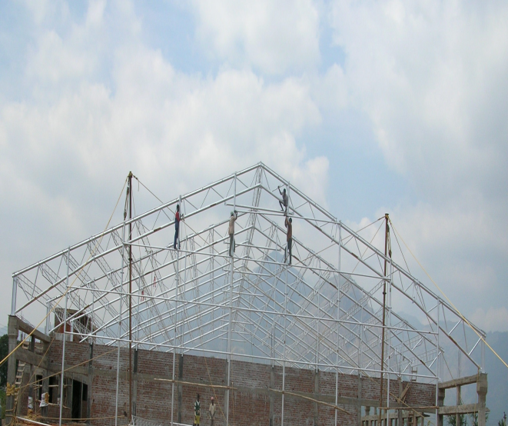
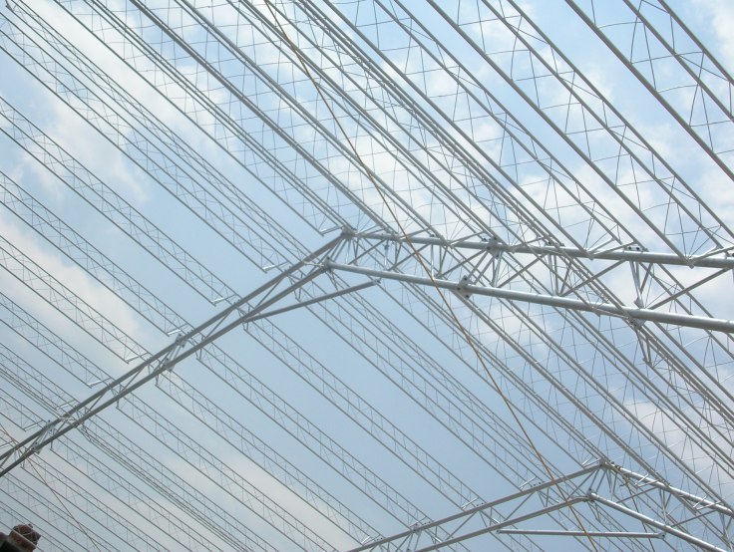
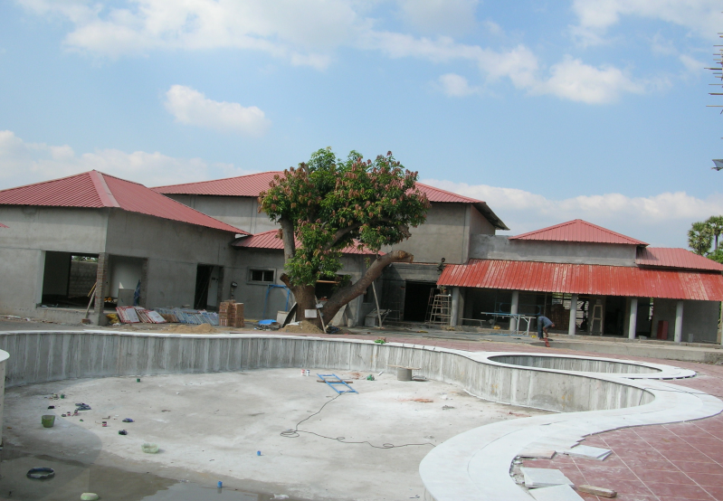
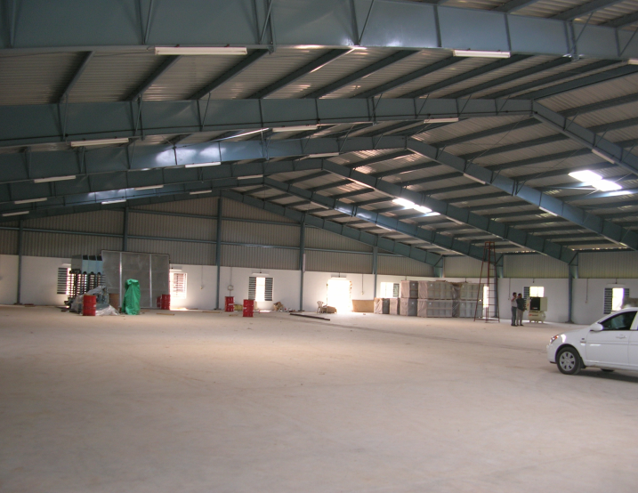
OUR PROJECTS IN INDIA

Slide 10
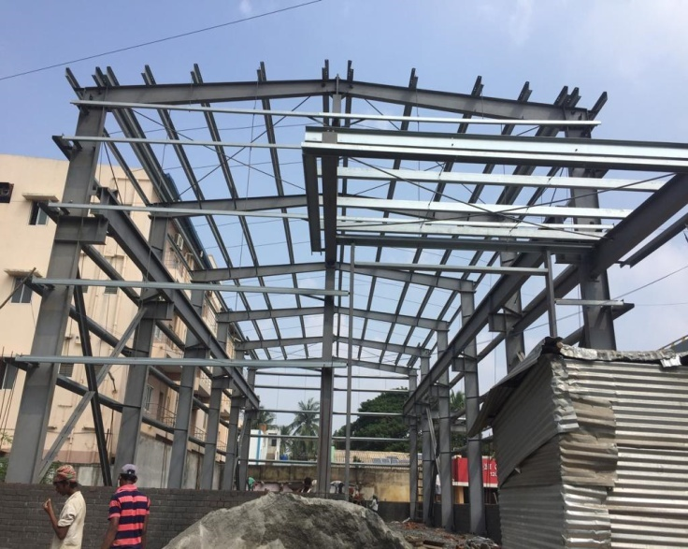
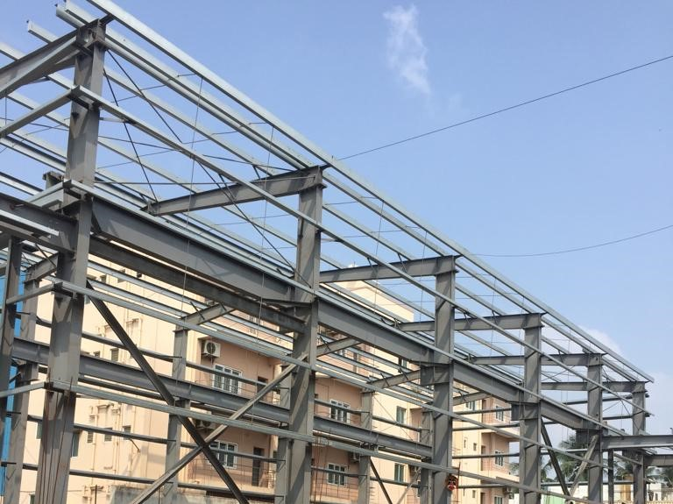
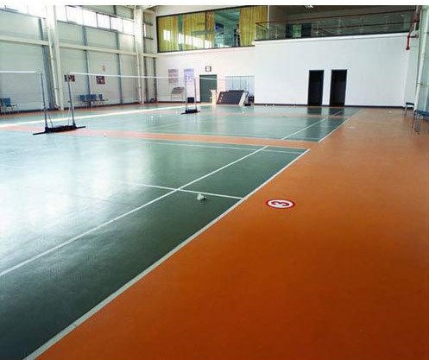
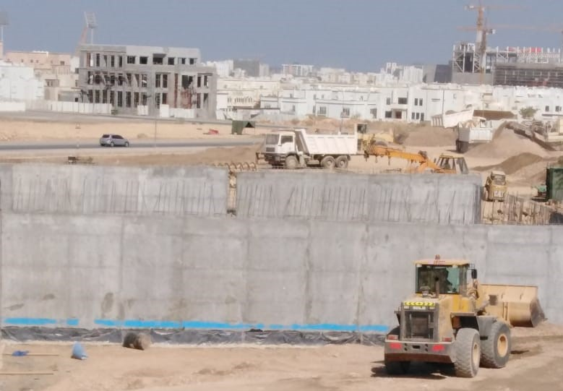
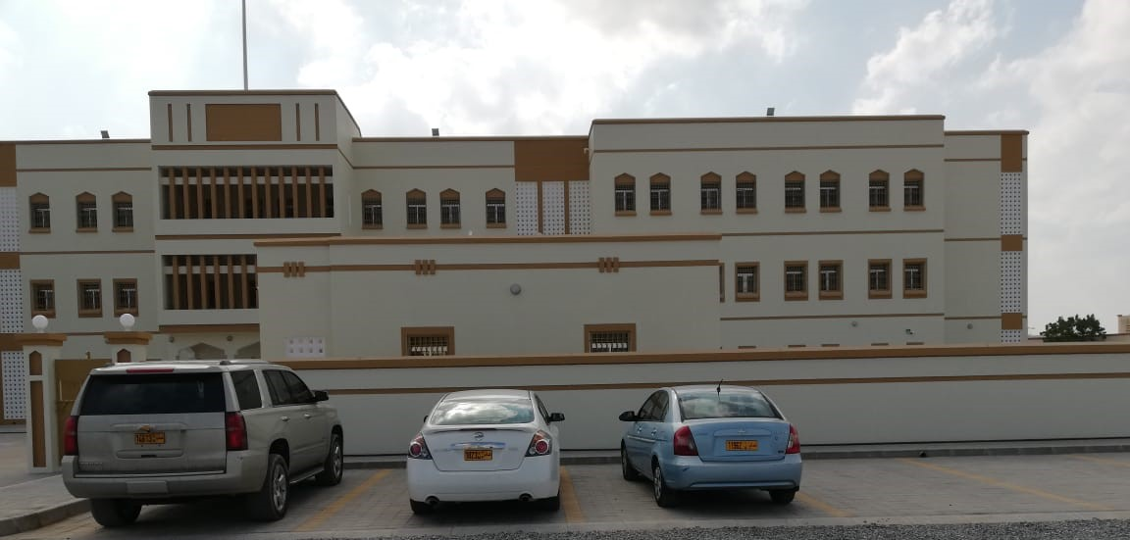
OUR PROJECTS IN MUSCAT

Slide 11
MR. ALEX GEORGE, CEO
ANUSHA ACCOUNTANT
DEIVANAI
PROJECT DEVELOPER
ARUN JOSEPH
PROJECT MANAGER
JOSHUA
CHIEF ENGINEER
JENIFER
OPERATOR
THIYAGU
VARADHARAJAN
MUTHUKUMAR
ERECTION AND SHEETING
HEMALATHA
STRUCTURAL ENGINEER
INIYA
DESIGN ENGINEER
DEVADARSHINI
DESIGN ENGINEER
RAJIV
MATHEW
CIVIL ENGINEER
RANGAN
FABRICATOR
ANAND
FABRICATOR
SYED ALI
ERECTION AND SHEETING
SHANMUGAM
ERECTION AND SHEETING

Slide 12

Contact us
Alex George, CEO
MASS Infra Projects & Services
HO : #255, First floor, Poonamallee High Road,
Aminjikarai, Chennai – 600 029
✆ + 91 9841098925
+ 91 44 48554122
✉ massinfraprojser@gmail.com massinfratn@gmail.com
Web: www.pebsteelconstructions.com

